Slide 1
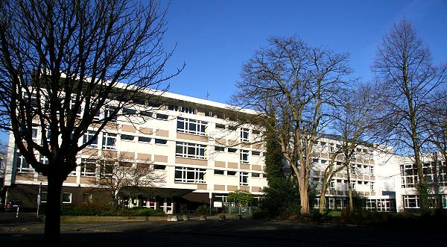
Welcome to Gelsenkirchen
Berufskolleg Königstraße
der Stadt Gelsenkirchen

Slide 2
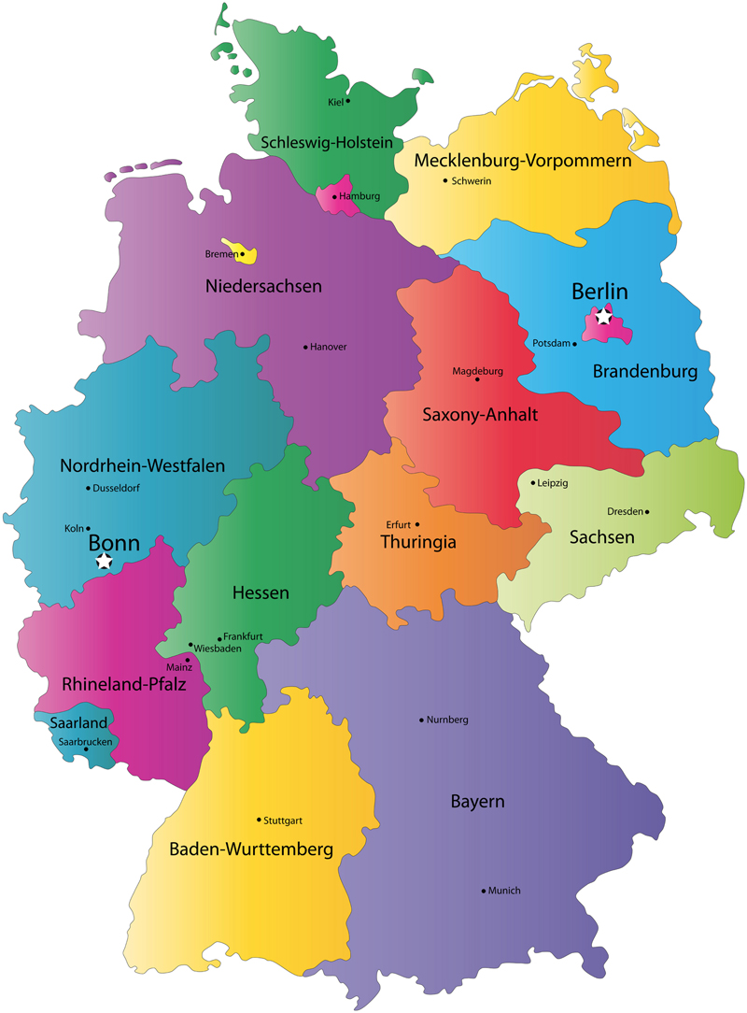
Germany

Slide 3
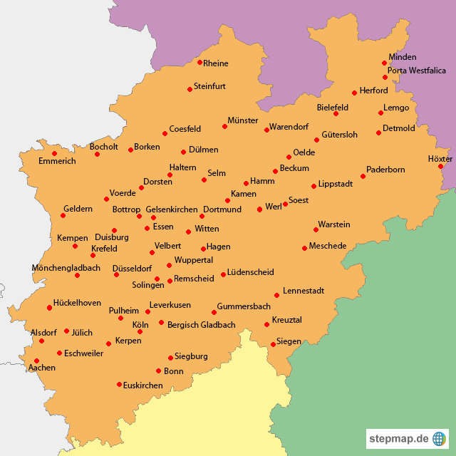
North-Rhine-Westphalia

Slide 4
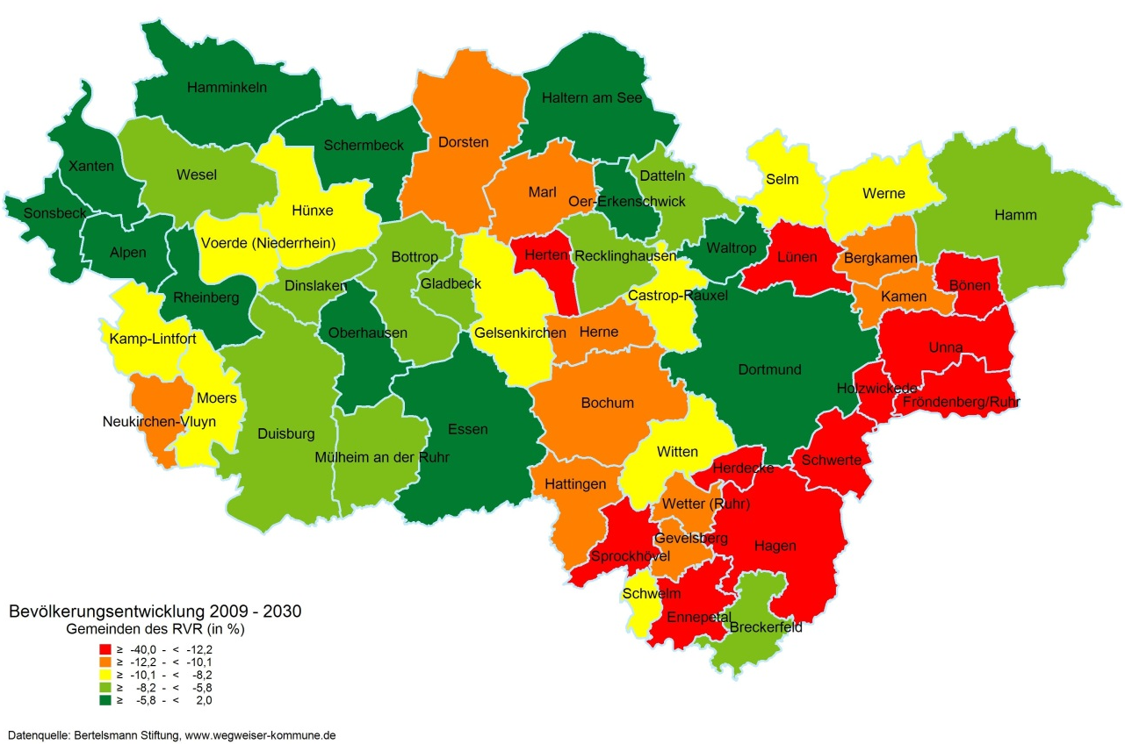
The Ruhrarea

Slide 5
Ruhrarea/Gelsenkirchen
Long history of immigration
heavy industry,
coal-mining, steel industry attracted immigrants from all over Europe seeking job opportunities
Refugees seeking asylum
Cultural melting pot
Due to far-reaching structural changes high unemployment rate/poverty in our region

Slide 6
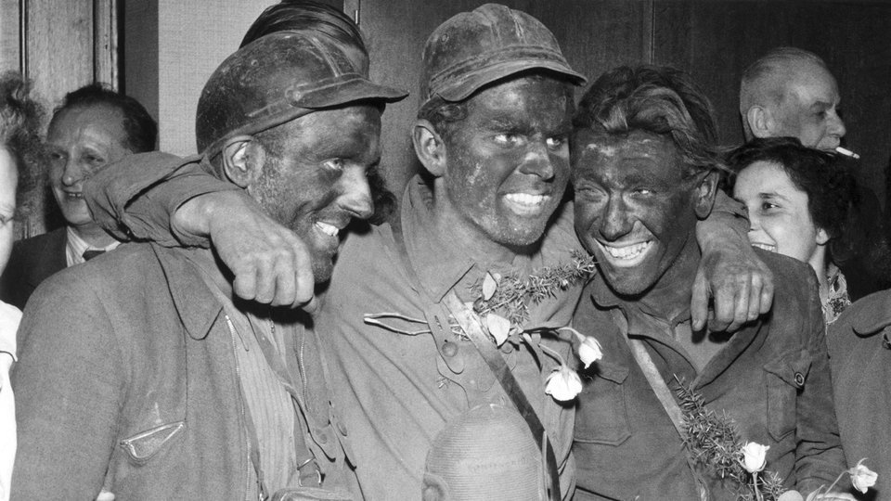
Coal miners in the past

Slide 7
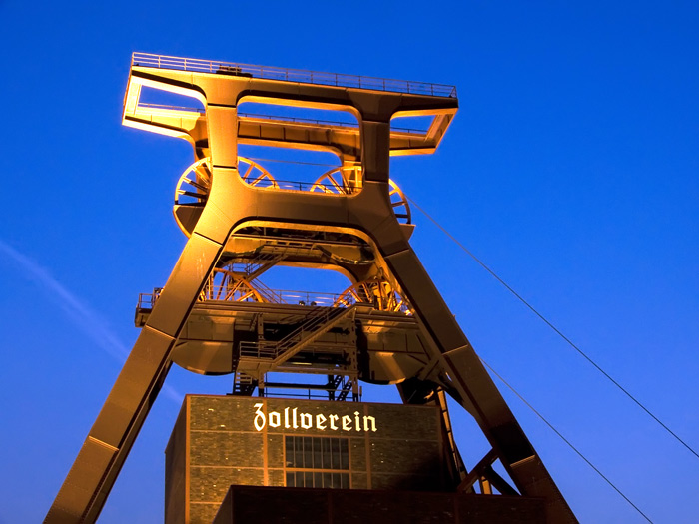
Old Coal Mine in Essen
Monument of the industrial age

Slide 8
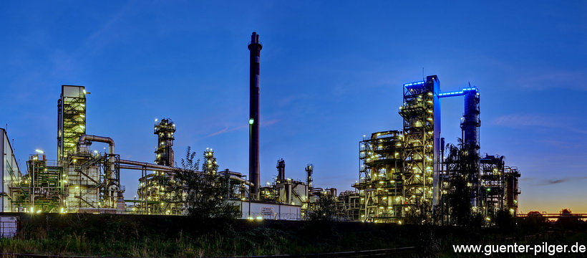
Refinery in Gelsenkirchen

Slide 9
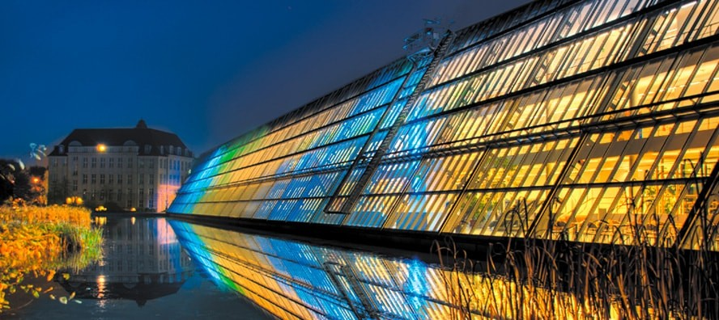
Science Park

Slide 10
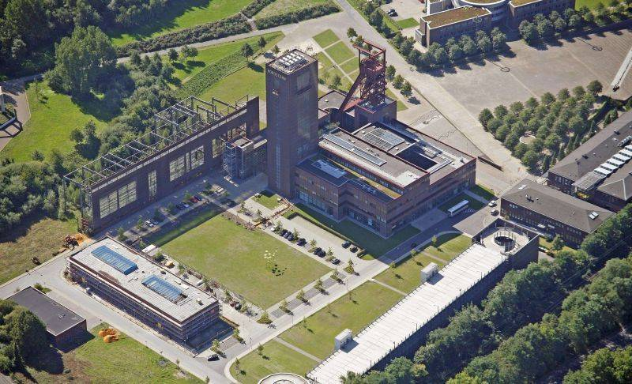
Former coal mine ‚Nordstern‘ Recreational park

Slide 11
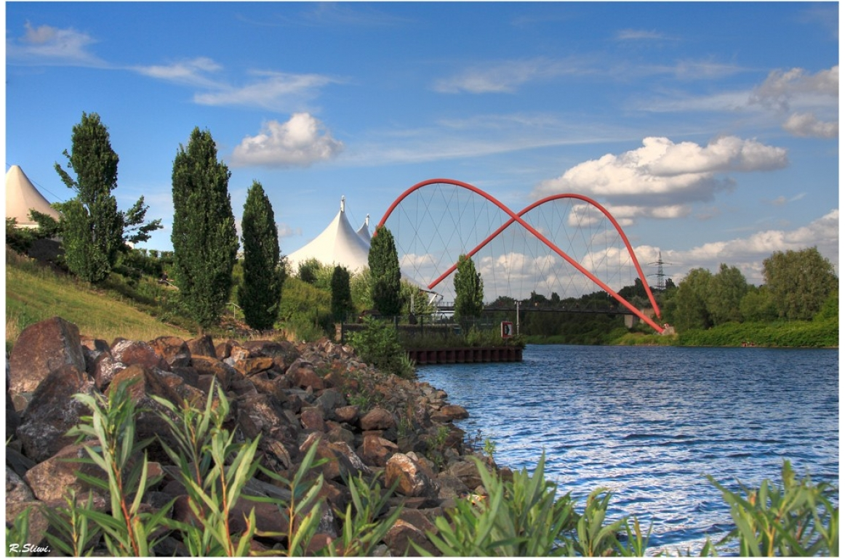

Slide 12
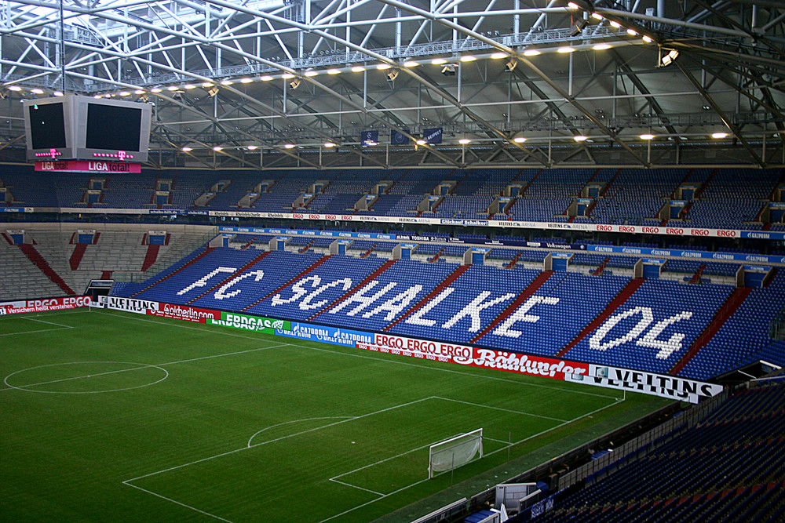
Our famous local football club

Slide 13
Our zoo

Slide 14
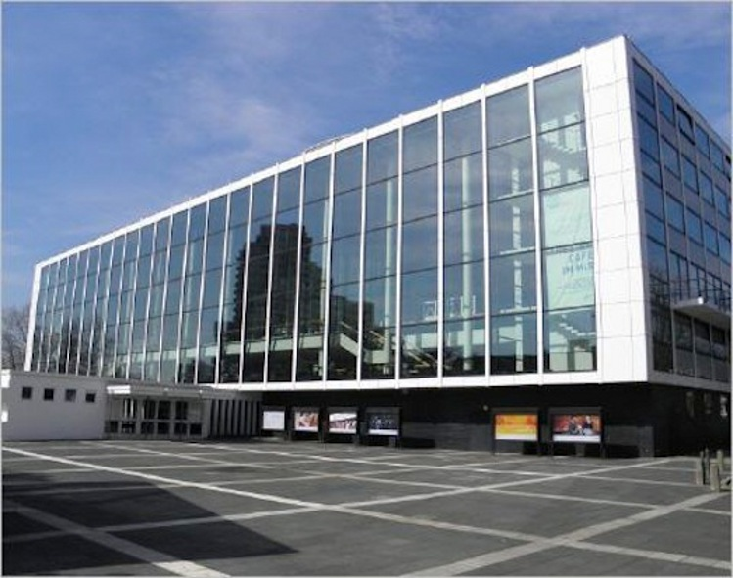
Our musical theatre

Slide 15
About our school …
Berufskolleg Königstrasse is a vocational college
Fusion of two vocational colleges in 2015
Now approx. 2800 students and 145 teachers
Multicultural background (more than 30 different nationalities working and learning together)

Slide 16
2015: Fusion of two schools

Slide 17
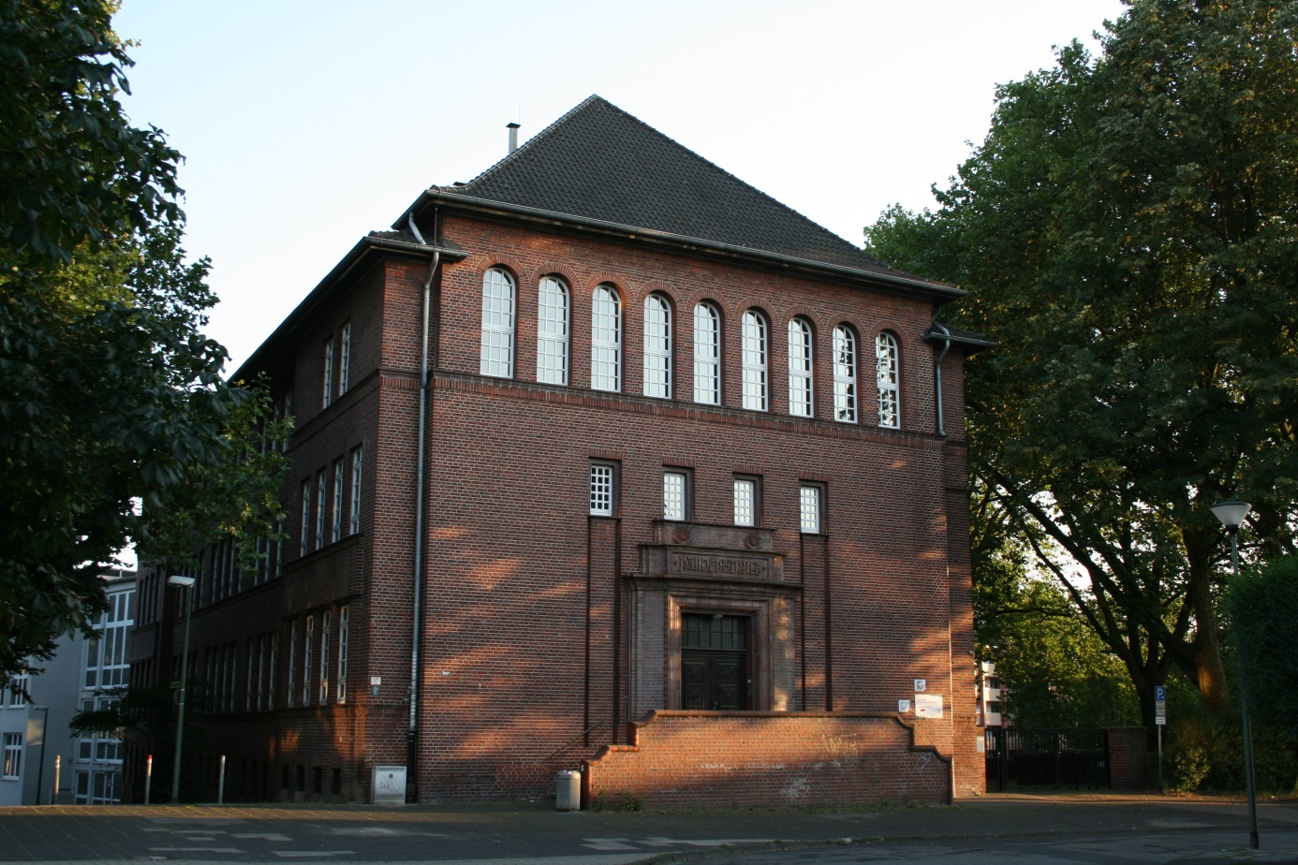
Location Augustastraße

Slide 18
course spectrum:
health
education
social work
hospitality
business and administration

Slide 19
We offer:
dual education (on-the-job training and schooling at Berufskolleg Königstrasse)
vocational preparation courses
job qualifications
all German school-leaving certificates from ‘Hauptschulabschluss‘ (equivalent: GCSEs) to ‘Abitur‘ (equivalent: A-levels)

Slide 20
Additionally (1):
school counselling:
team of seven teachers having undergone special training
students can make use of our team’s services in case of...
problems within the family
social issues
academic/studying problems
bullying and cyber-bullying
violence
drugs and addiction
pregnancy
financial problems
dealing with authorities of any kind
funding by the state

Slide 21
Additionally (2):
Fairtrade/One World:
team of teachers
organising projects and workshops with students
offering fair trade products
information on sustainability
‘Gesunde Schule‘:
team of teachers
organising health projects/health days
informing students about health related issues
supporting development of a healthier school life

Slide 22
Additionally (3):
Europe:
team of teachers
applying for funding
organising projects (Comenius, Erasmus+)
creating European awareness (e.g.‘Europatag‘)
offering work placements
organising job shadowing in other European countries /workshops for teachers
organising trips and student exchanges
supporting co-operation with European partner schools

Slide 23
We hope you will enjoy your stay

