Slide 1
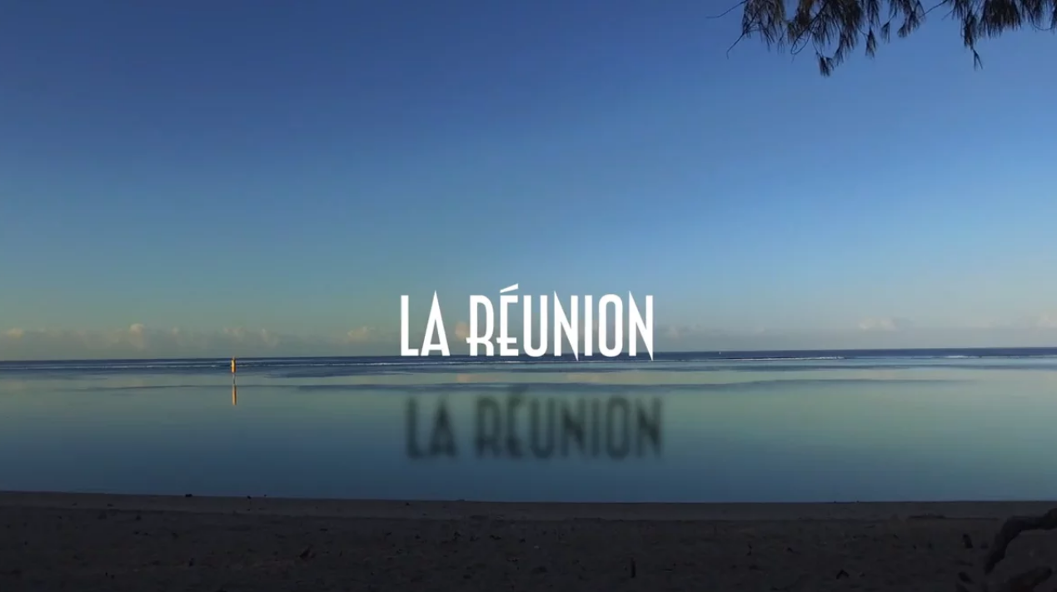
KITE Project
Louis Payen

Slide 2

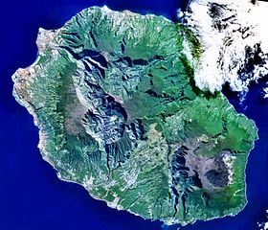
Here we are!!!

Slide 3
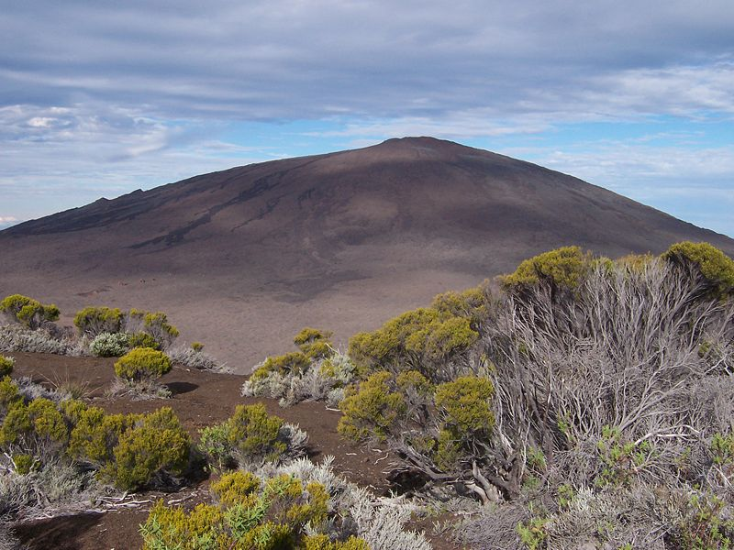
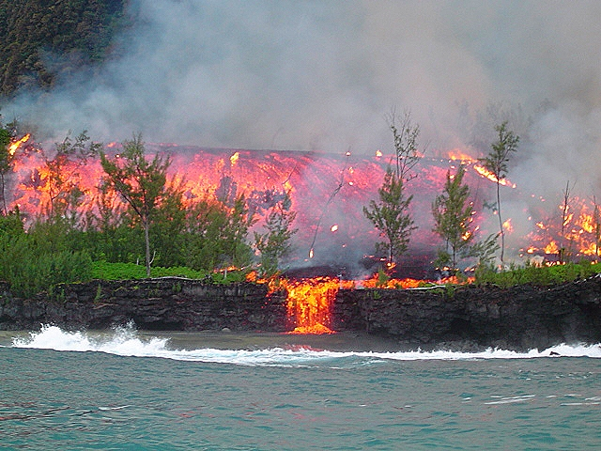
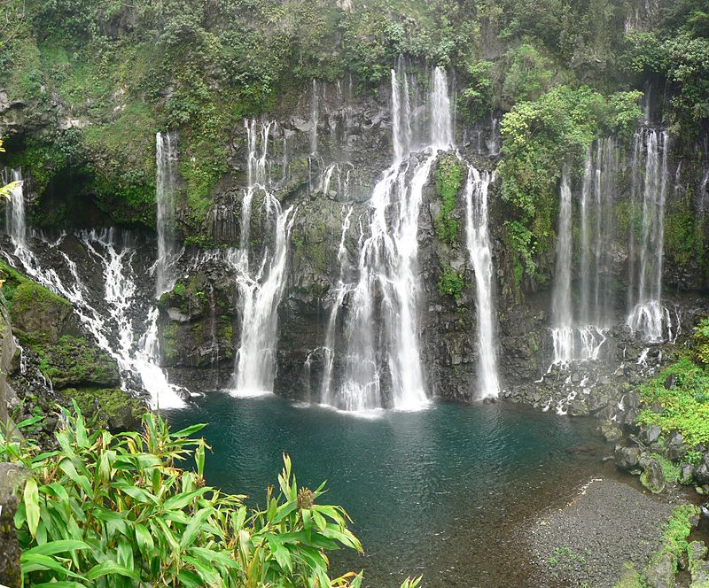
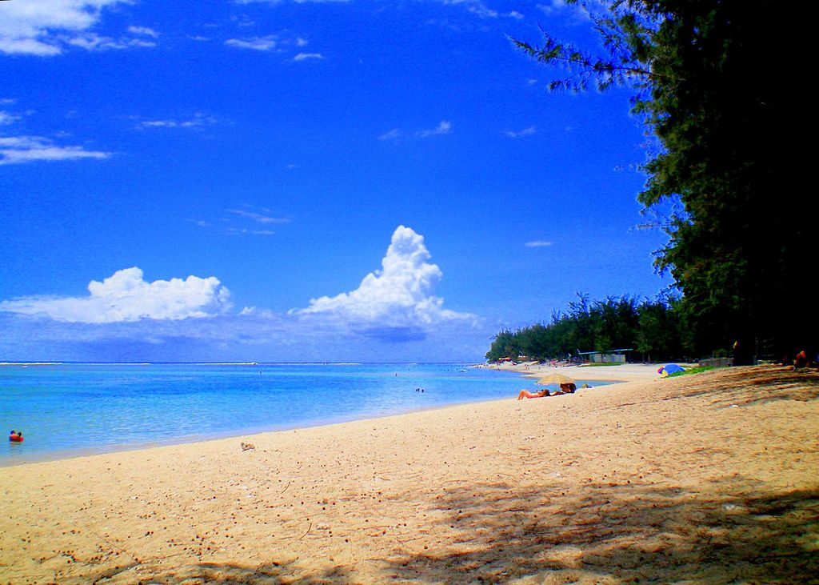
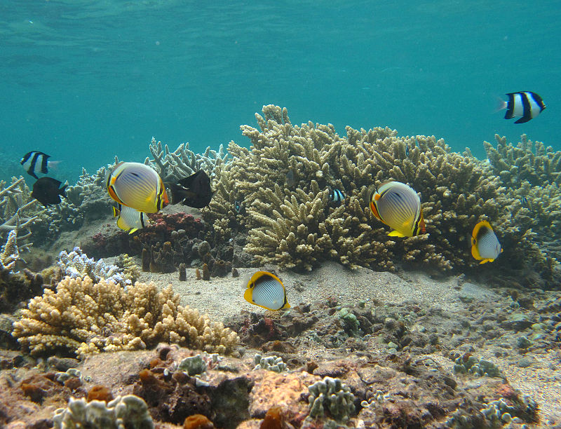
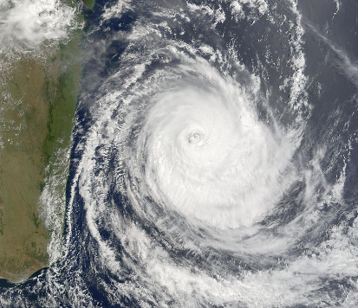
The intense island

Slide 4

… in
Saint Paul

Slide 5
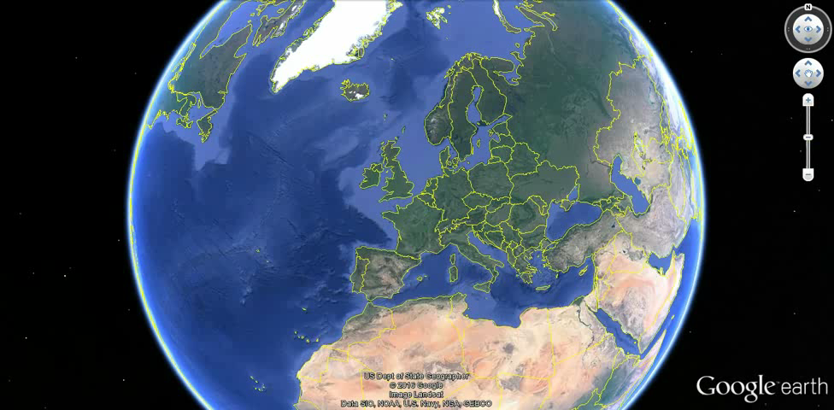

Slide 6

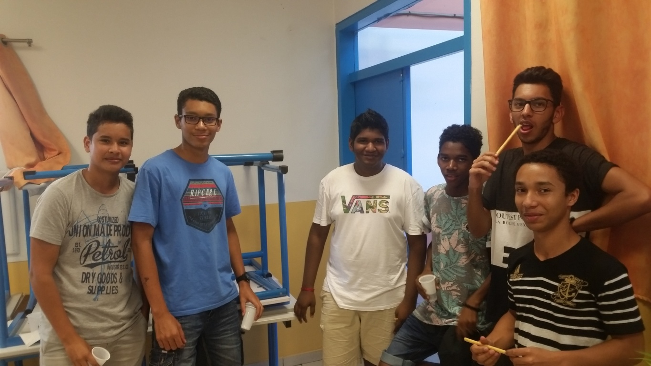
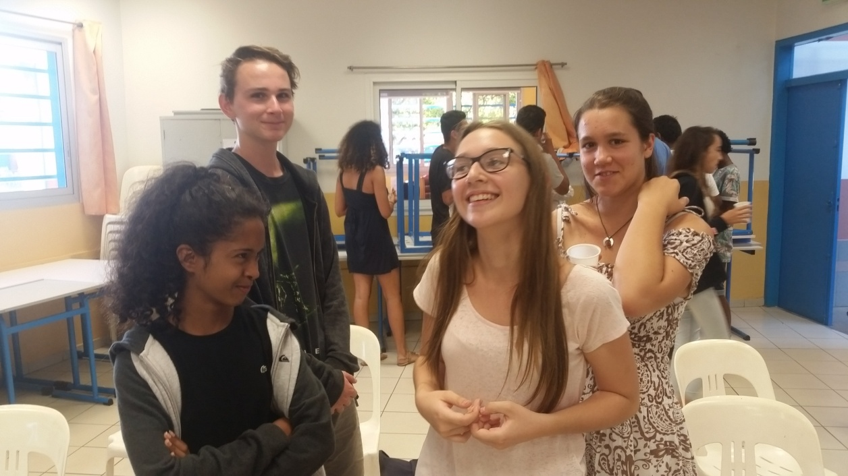
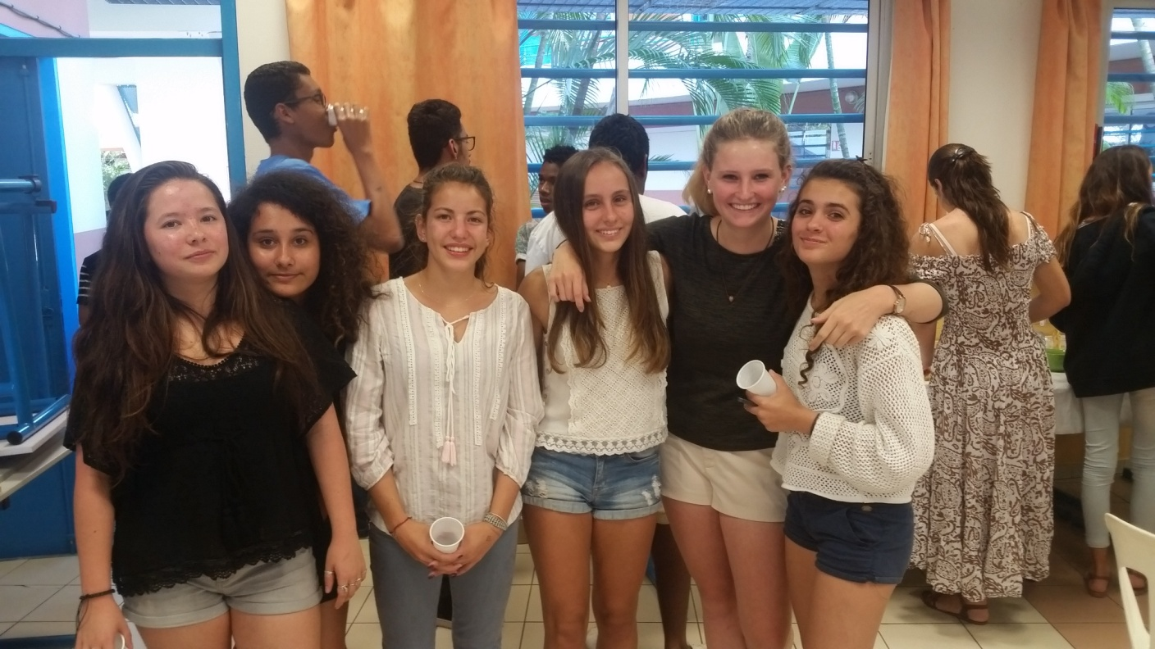
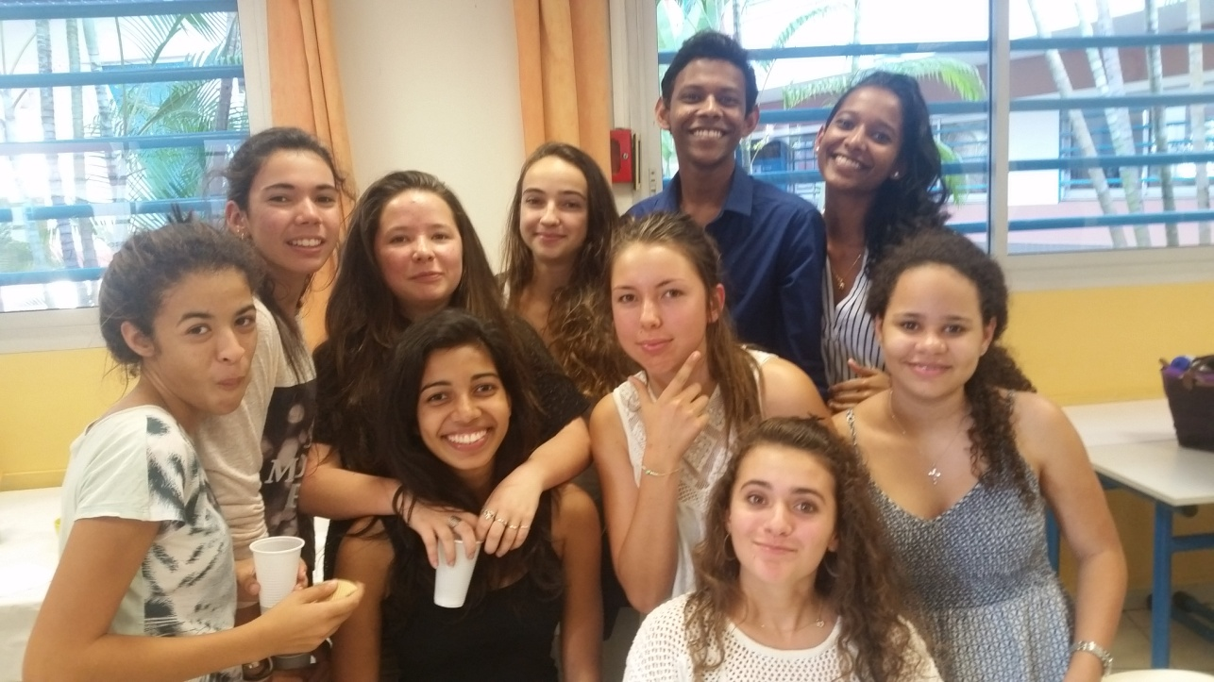

Slide 7
Name : Lycée Louis Payen (Highschool)
Age : 23 years old
Size : Medium (700 pupils, 70 teachers)
Pupils : 15-18 years old
Location : Saint Paul, on the westcoast of the island
Teaching : Comprehensive and technical school (business management)
Speciality : Ingeneering (mechanics and programming)
Focus : Foreign languages learning, ICT

Slide 8
Foreign Languages
Chinese, English, German and Spanish are the languages you can study here. Our high school offers a European Section in German and English.
We promote and organize educational exchange programmes with Germany and South Africa.
ICT
We have a fully equipped school with a computer, an internet access, a projector and an interactive whiteboard in each classroom.
We also have IT-rooms available with headphones and microphones, mp4-players, a visio-conferencing system.
We have a solid digital work environment at our disposal with multiple interactive and collaborative applications.

Slide 9


